Slide 1
Concur Expenses

Slide 2
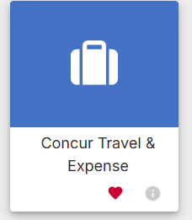
How to Access Concur
Go to the “My Rutgers” website
Select the “Apps” section on the left-hand side
Multiple squares that make up a big square
Search for “Concur” in the search bar (top left)
You can even favorite so that it is easily accessible for later

Slide 3
How to add a delegate
Click your user in the top right corner (little person) and click profile settings
On the left-hand side under "Expense Settings" select "expense delegates"
Click the add button and then search my name "Vincent Andoldi"
Make sure you check off all the boxes besides receives emails

Slide 4
Creating an Authorization Request
Authorization requests are required anytime you are traveling and must be submitted BEFORE travel
This does not include travel to a field site or one day business meetings
Process:
On your Concur Homepage select “Authorization Requests”
Select “Create New Request”
Form header page will be completed including the following
Request Type, Trip name, Trip Type, Business Purpose, Business Travel Start and End date, Destination address (City, Country/Region), Personal travel and dates, Project/GL Charging information, and comments on what they travel is for.

Slide 5
Authorization Request Header Page

Slide 6
Adding expense to Authorization Request
All Expenses that are expected to occur during travel must be added
This includes hotels, Airfare, per diem (next slide), other meals, car mileage or anything else that may occur
All receipts must also be attached
Concur Itineraries for Airfare, Conference registrations/Conference Agendas, any receipt for something that was paid for prior to travel taking place
Lodging must be specified within the comment section of the expense to one of the following
Air BnB, Conference designated hotel (program attached showing the hotel), Concur Booked hotel. This ensure that the approvers are able to know what needs to be attached is attached correctly.
Again, Project/GL charging information will also be required and if you don’t have it handy feel free to reach out!
Once approved, you will need to wait until AFTER travel to complete the Expense Report.

Slide 7
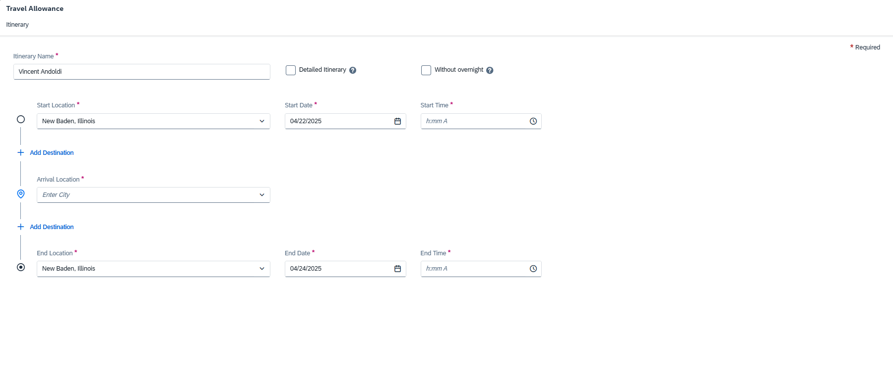
Adding Travel Allowance (Per Diem)
If taking Per Diem, you must go into the “Manage Travel Allowance” drop within the Authorization Request.
Select Add Travel Allowance
Input all details that are required including Start Location, End Location, etc.

Slide 8
Creating an Expense Report (Non-Travel)
Non-Travel Expense reports are used for any type of expense that is “Non-Travel” or for local travel to say field sites or one day business meetings
The process is very similar to the Authorizations Requests
Process:
On your Concur Homepage select “Expense Reports”
Select “Create New Report”
Form header page will be completed including the following
Request Type (Non-Travel), Report Name, Project/GL Charging information, and comments on what report is for.

Slide 9
Non-Travel Expense Report Header

Slide 10
Adding expense to Non-Travel Expense Report
Select “Add Expense” and then “Create new Expense” within the report
From there follow the prompts to work through the required information
This can be anything from last minute supplies to a business meeting with colleagues
Within these expenses answer all questions to the best of your ability depending on the item/expense that was incurred.
Once all expenses are added, make sure that all receipts were properly attached. This ranges from physical receipts to agendas for business meetings.
Backup is required on every expense line to show that it was necessary, and business related.
Project/GL charging information will also be required and if you don’t have it handy feel free to reach out!
Once completed please reach out to Vincent Andoldi to review the report before submission.

